Slide 1
Community Mobility Resilience Plan
Public Workshop #2
January 14, 2021
Virtual Meeting
Notes:
Carrie

Slide 2
Meeting Agenda
Welcome, Introductions, and Agenda review
Plan Overview and Context
Overview of Climate Impacts and Resilience Strategies
Plan Implementation
Question and Answer Period
Action Items and Next Steps
Notes:
Carrie and Matt

Slide 3
Community Mobility Resilience Plan Overview
Project Purpose
The plan will develop detailed actions, funding strategies, and partnerships to respond and adapt to the local impacts of climate change on the transportation system and its associated impacts.

Slide 4
Community Mobility Resilience Plan Overview
✓
Fiscal Impact White Paper
✓
Public Workshops
Heat Impact White Paper
Community Mobility Resilience Plan
✓
✓
Flood Impact White Paper
Working Groups
Implementation + Community Resilience Task Force
Implementation
Community Resilience Task Force
Notes:
Project Process
Impacts addressed through working groups and white papers:
Precipitation and flooding impacts
Heat-related impacts
Fiscal impacts of changing mobility landscape
Community Resilience Task Force established for assistance during plan implementation

Slide 5
Project Timeline
October 2019
Working Group Meeting
February 2020
1st Public Workshop
February 2020
White Papers Released
March 2020
Working Group Meeting
Fall 2020
Working Group Meeting
Winter 2020
Public Draft Plan
& Resilience Task Force
Winter 2020/21
Public Workshop Roadshow
Winter 2020/21
Adopt Final Plan
Notes:
Carrie

Slide 6
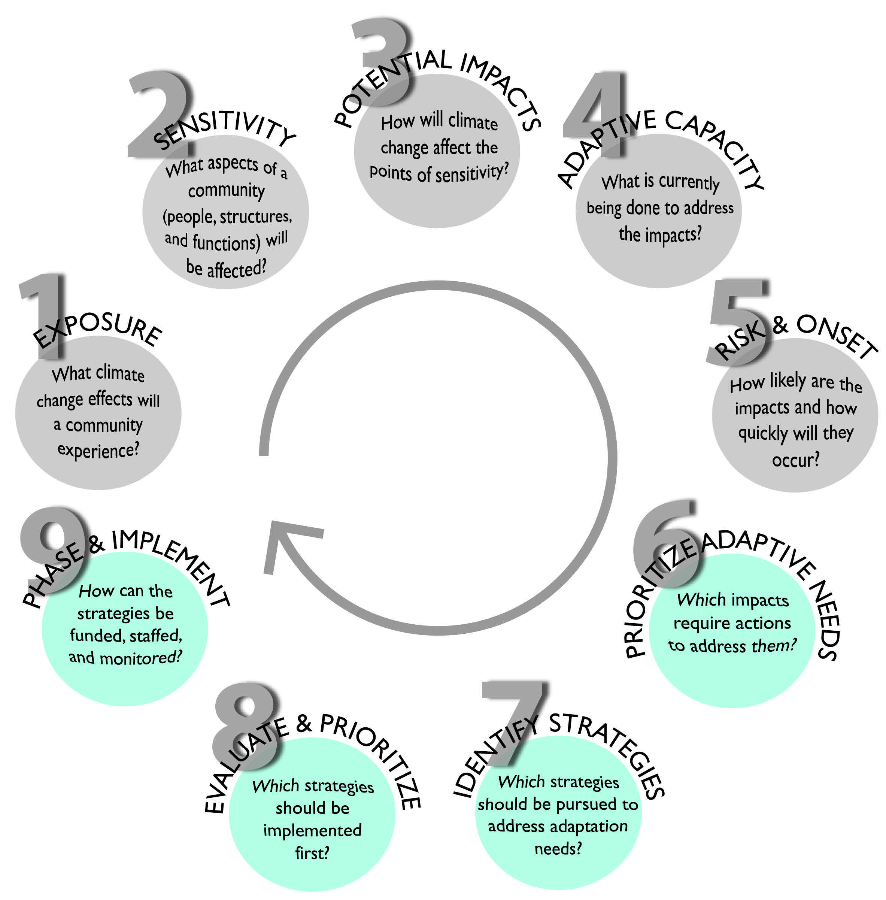
Adaptation
Planning Process
California Adaptation Planning Guide 2.0
  Vulnerability Assessment (9 Step Process)
  Adaptation Strategy Development
Using FHWA and Caltrans Guidance as well
SACOG Adaptation Plan

Slide 7
Fiscal Impacts and Resilience Strategies

Slide 8
Vehicle-Related Revenue
General Fund Revenue
Sales Tax Revenue
Notes:
In addition, 50% of Public Works O&M comes from gas tax and Measure A sales tax.

Slide 9







What’s down the road?
Revenue
Costs
Population Growth
EVs
CAP
Increasing Road Usage
Declining Fuel Sales
Declining Car Sales
AVs
Existing Trends
Increasing Demand for City Services
Increasing Utility Usage
Notes:
Mention Climate Action Plan mitigates increase in VMT to a certain extent (road maintenance costs)

Slide 10
Model Output

Slide 11
Revenue per Household
Notes:
The high estimate is Scenario 2 (personal AV ownership) coupled with the low household estimate, and the low estimate is Scenario 3 (shared automated TNCs) coupled with the high household estimate.

Slide 12
A FORWARD-LOOKING TRANSPORTATION SYSTEM
A-1: REDUCE PARKING REQUIREMENTS TO MATCH REDUCED VEHICLE OWNERSHIP
  Strategies to promote walkable neighborhoods and increase underutilized land uses devoted to parking
  A-2: SUPPORT DEVELOPMENT OF EV INFRASTRUCUTRE TO INCREASE EV OWNERSHIP
    Strategies to promote EV ownership and opportunities for EV related-revenue streams for the City
Notes:
A-1: REDUCE PARKING REQUIREMENTS TO MATCH REDUCED VEHICLE OWNERSHIP
Implementation Actions
Reduce parking requirements and/or create parking maximums to promote walkable neighborhoods and increase property tax revenue.
Update the City’s zoning code to allow for shared parking districts to reduce the total land required for parking.
Promote or require park-once-and-walk districts to increase the total potential land available for building footprints.
A-2: SUPPORT DEVELOPMENT OF EV INFRASTRUCUTRE TO INCREASE EV OWNERSHIP
Implementation Actions
Work with key stakeholders, including the Elk Grove Chamber of Commerce and Sacramento Municipal Utility District, to promote EV charging stations at appropriate existing commercial developments.
Identify business types that will benefit from the installation of EV charging stations (e.g., businesses with longer in-store dwell times, such as movie theaters, restaurants, and grocery stores).
Use resources and information included in the publication Public EV Charging Business Models for Retail Site Hosts to inform this strategy (Atlas Public Policy 2020).
A-3: IMPLEMENT THE CITY’S AUTONOMOUS/CONNECTED READINESS PLAN
Implementation Actions
Prepare the City’s transportation infrastructure (e.g., roadways, parking lots) for AV technologies.
Ensure adoption of AV technologies does not increase VMT in the City and does not disproportionately impact low-income or other vulnerable populations.
A-4: ADVOCATE FOR A STATEWIDE VEHICLE MILES TRAVELED TAX AND PREPARE FOR LOCAL IMPACTS
Implementation Actions
Promote participation among the City and Elk Grove residents in future road charge pilot programs, communicating the benefits of the program to residents and elected officials.
Lobby for the equitable implementation of a road charge program that does not disproportionately affect residents with low-income residents or those with long commutes.

Slide 13
A FORWARD-LOOKING TRANSPORTATION SYSTEM
A-3: IMPLEMENT THE CITY’S AUTONOMOUS/CONNECTED READINESS PLAN
  Strategies to promote benefits of autonomous vehicle adoption while avoiding negative impacts
A-4: ADVOCATE FOR A STATEWIDE VEHICLE MILES TRAVELED TAX AND PREPARE FOR LOCAL IMPACTS
    Strategies to support State’s transition to VMT tax while ensuring it is implemented equitably
Notes:
A-1: REDUCE PARKING REQUIREMENTS TO MATCH REDUCED VEHICLE OWNERSHIP
Implementation Actions
Reduce parking requirements and/or create parking maximums to promote walkable neighborhoods and increase property tax revenue.
Update the City’s zoning code to allow for shared parking districts to reduce the total land required for parking.
Promote or require park-once-and-walk districts to increase the total potential land available for building footprints.
A-2: SUPPORT DEVELOPMENT OF EV INFRASTRUCUTRE TO INCREASE EV OWNERSHIP
Implementation Actions
Work with key stakeholders, including the Elk Grove Chamber of Commerce and Sacramento Municipal Utility District, to promote EV charging stations at appropriate existing commercial developments.
Identify business types that will benefit from the installation of EV charging stations (e.g., businesses with longer in-store dwell times, such as movie theaters, restaurants, and grocery stores).
Use resources and information included in the publication Public EV Charging Business Models for Retail Site Hosts to inform this strategy (Atlas Public Policy 2020).
A-3: IMPLEMENT THE CITY’S AUTONOMOUS/CONNECTED READINESS PLAN
Implementation Actions
Prepare the City’s transportation infrastructure (e.g., roadways, parking lots) for AV technologies.
Ensure adoption of AV technologies does not increase VMT in the City and does not disproportionately impact low-income or other vulnerable populations.
A-4: ADVOCATE FOR A STATEWIDE VEHICLE MILES TRAVELED TAX AND PREPARE FOR LOCAL IMPACTS
Implementation Actions
Promote participation among the City and Elk Grove residents in future road charge pilot programs, communicating the benefits of the program to residents and elected officials.
Lobby for the equitable implementation of a road charge program that does not disproportionately affect residents with low-income residents or those with long commutes.

Slide 14
A RESILIENT AND DIVERSIFIED TAX BASE
B-1: IMPLEMENT GENERAL PLAN CHAPTER 5 “ECONOMY AND THE REGION
  Focuses on attracting new industries and live-work strategies to diversify tax base
B-2: DEVELOP AND IMPLEMENT VEHICLE-RELATED TAX REVENUE OFFSET POLICY
  Focuses on potential tax and fiscal polices to offset the impacts of lost vehicle-related revenue
Notes:
RDT-1: Implement General Plan Chapter 5, “Economy and the Region
Implement “Economy and the Region,” of the City’s General Plan
Prioritize City expansion of the City’s broadband and fiberoptic cable network to attract new large employers.
Focus future planning decisions to attract remote workers from industries shifting to permanent work-from-home policies
RDT-2: Explore New Tax Offset Policy
Explore other forms of tax increases, outside of sales tax, to offset decreases in vehicle-related sales tax revenue in the future.
Explore the feasibility and likely acceptance of an increase in the City’s local sales tax as a tool to offset revenue lost
Explore options to develop a sales tax increase on e-commerce conducted in the City to capture revenue from business transactions that otherwise would be taxed from brick and mortar businesses.

Slide 15
Extreme Heat Impacts

Slide 16
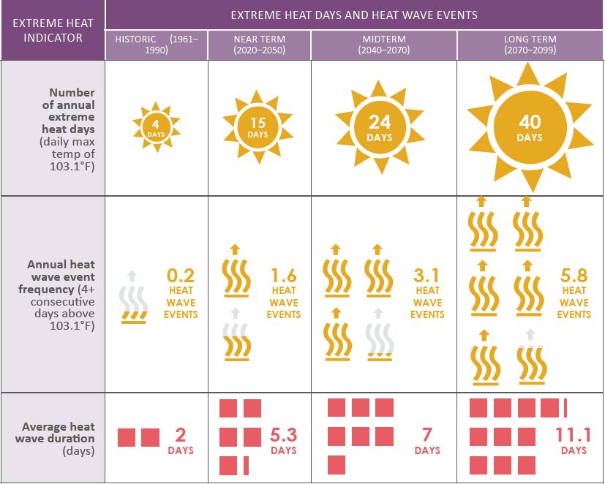
Extreme Heat Days

Slide 17
Heat Wave Events

Slide 18
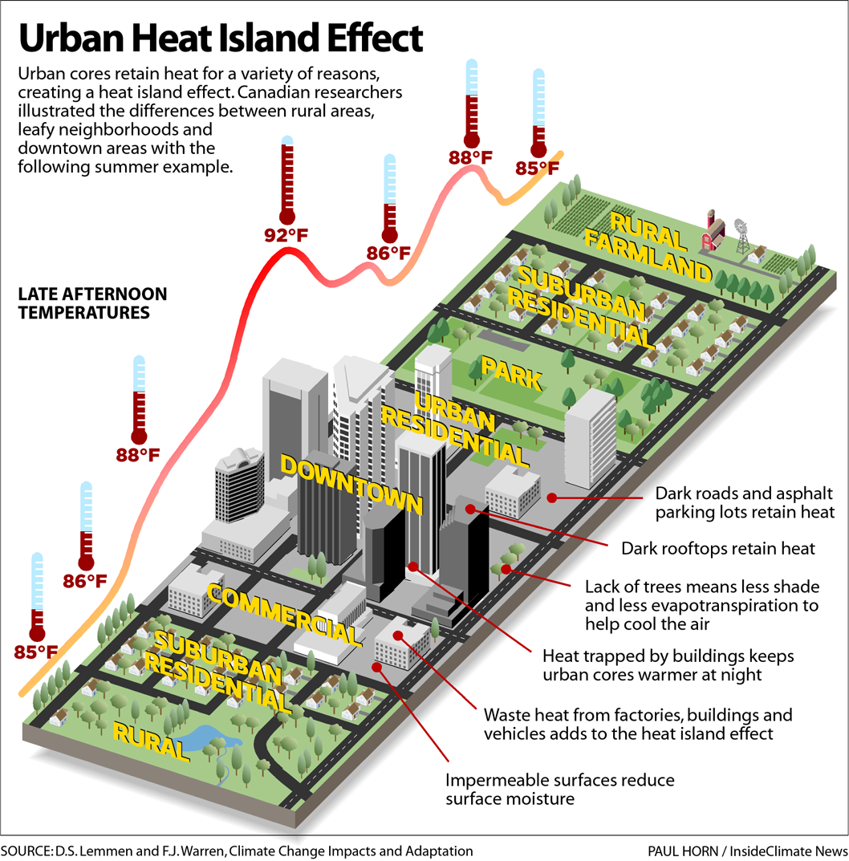
Heat Impacts
Urban Heat Island Impacts
  Increased daytime and nighttime temperatures
  Decreased ability for nighttime cooling
  Increased energy demand for cooling
  Impaired water quality
  Decreases in air quality

Slide 19
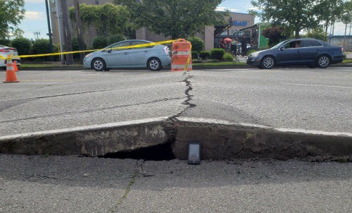
Heat Impacts
Transportation Impacts
  Asphalt rutting and buckling
  Rail buckling and potential for train derailment
  Transit vehicles overheating
  Thermal expansion of bridge joints
  Decreased comfort for walking and biking

Slide 20


Heat Impacts
Population Impacts
  Health risks from ozone and particulate air pollution
  Heat-Related Illnesses
  Increased risk for vulnerable populations including seniors, youth, and homeless
Community Impacts
  Emergency services and hospital room visits
  Increased energy demand and associated costs for cooling

Slide 21
Flooding Impacts

Slide 22
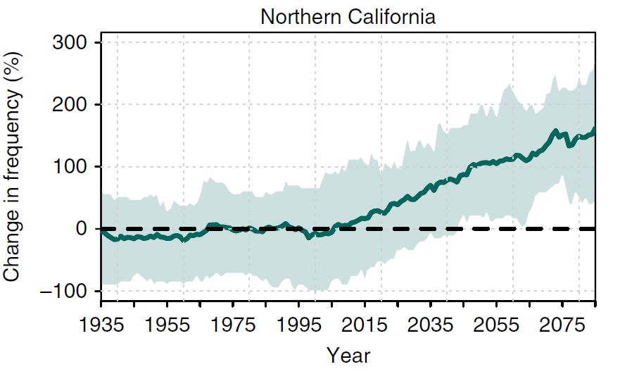
Flooding Exposure
Change in frequency of extremely wet seasons 1935 to 2085
Increase in frequency of November–March precipitation levels exceeding historic
Impacts from large storm events projected to increase
Source: Swain et al. 2018
Notes:
Increase in frequency of wet seasons
Impacts from large storm events projected to increase

Slide 23
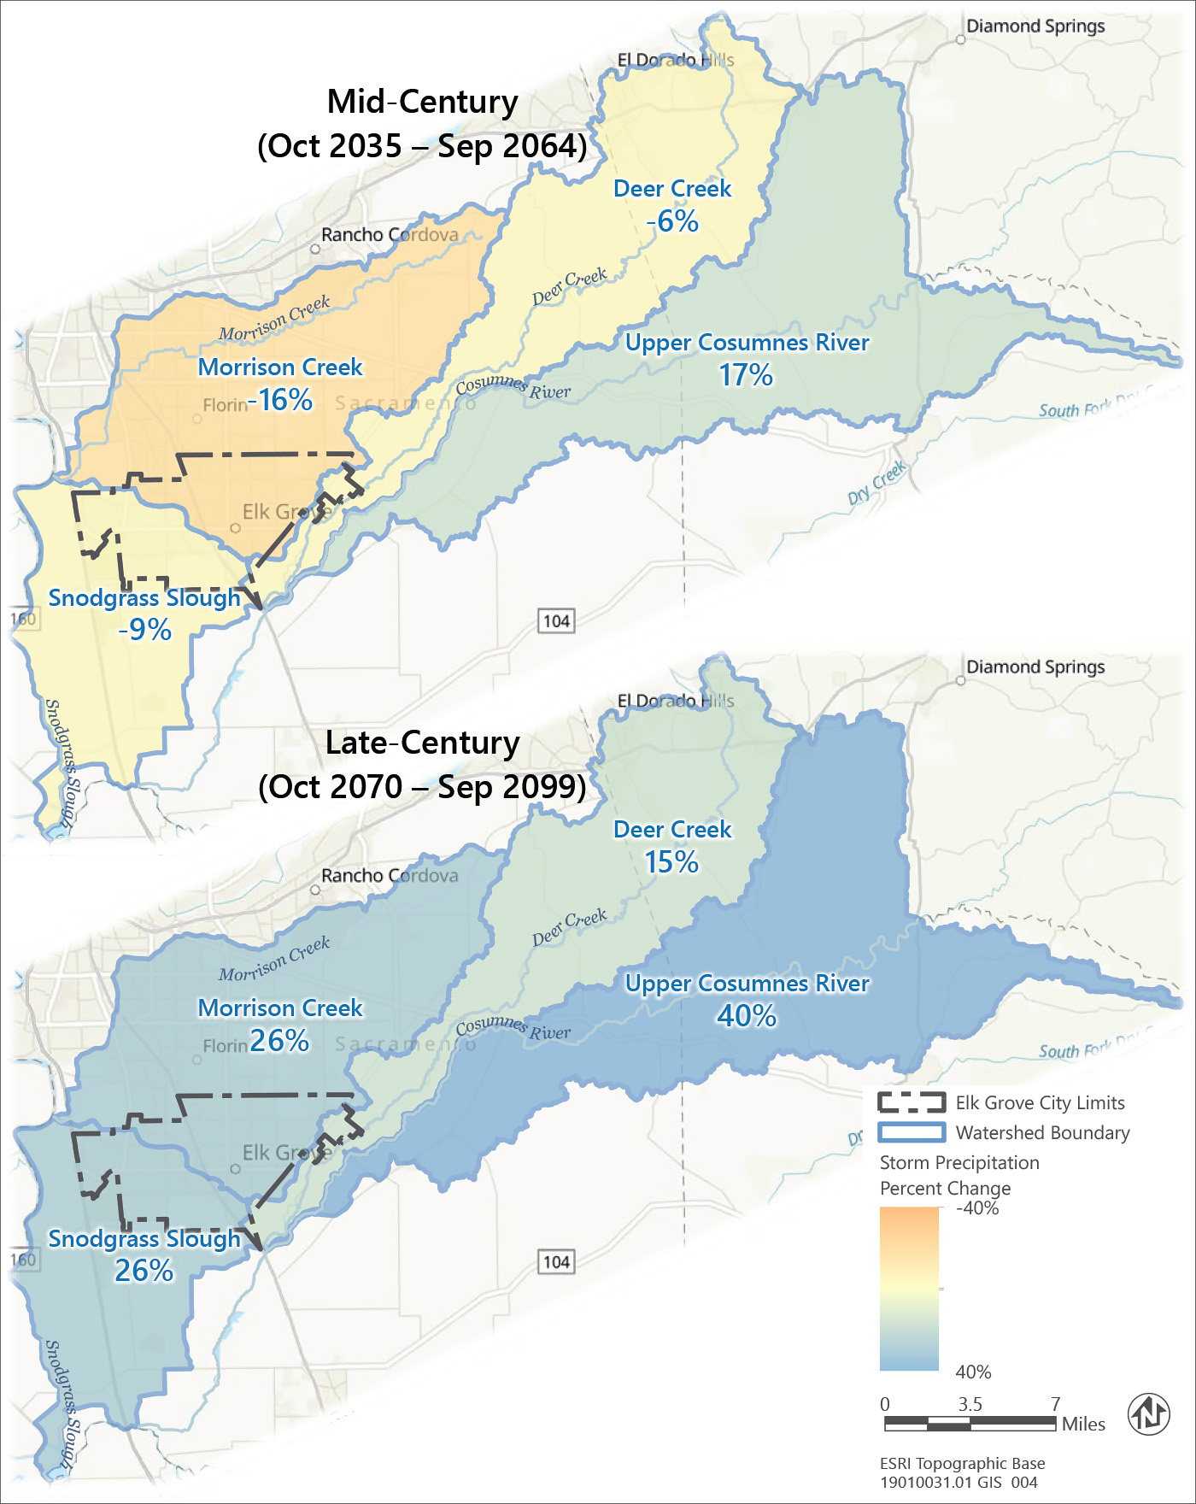
Flooding Exposure
Change in rainfall during 100-year storm events
Increase in November –March precipitation levels exceeding historic
Small increases in small storm events may affect localized flooding
Increase in intensity and impacts from large regional storm events projected

Slide 24
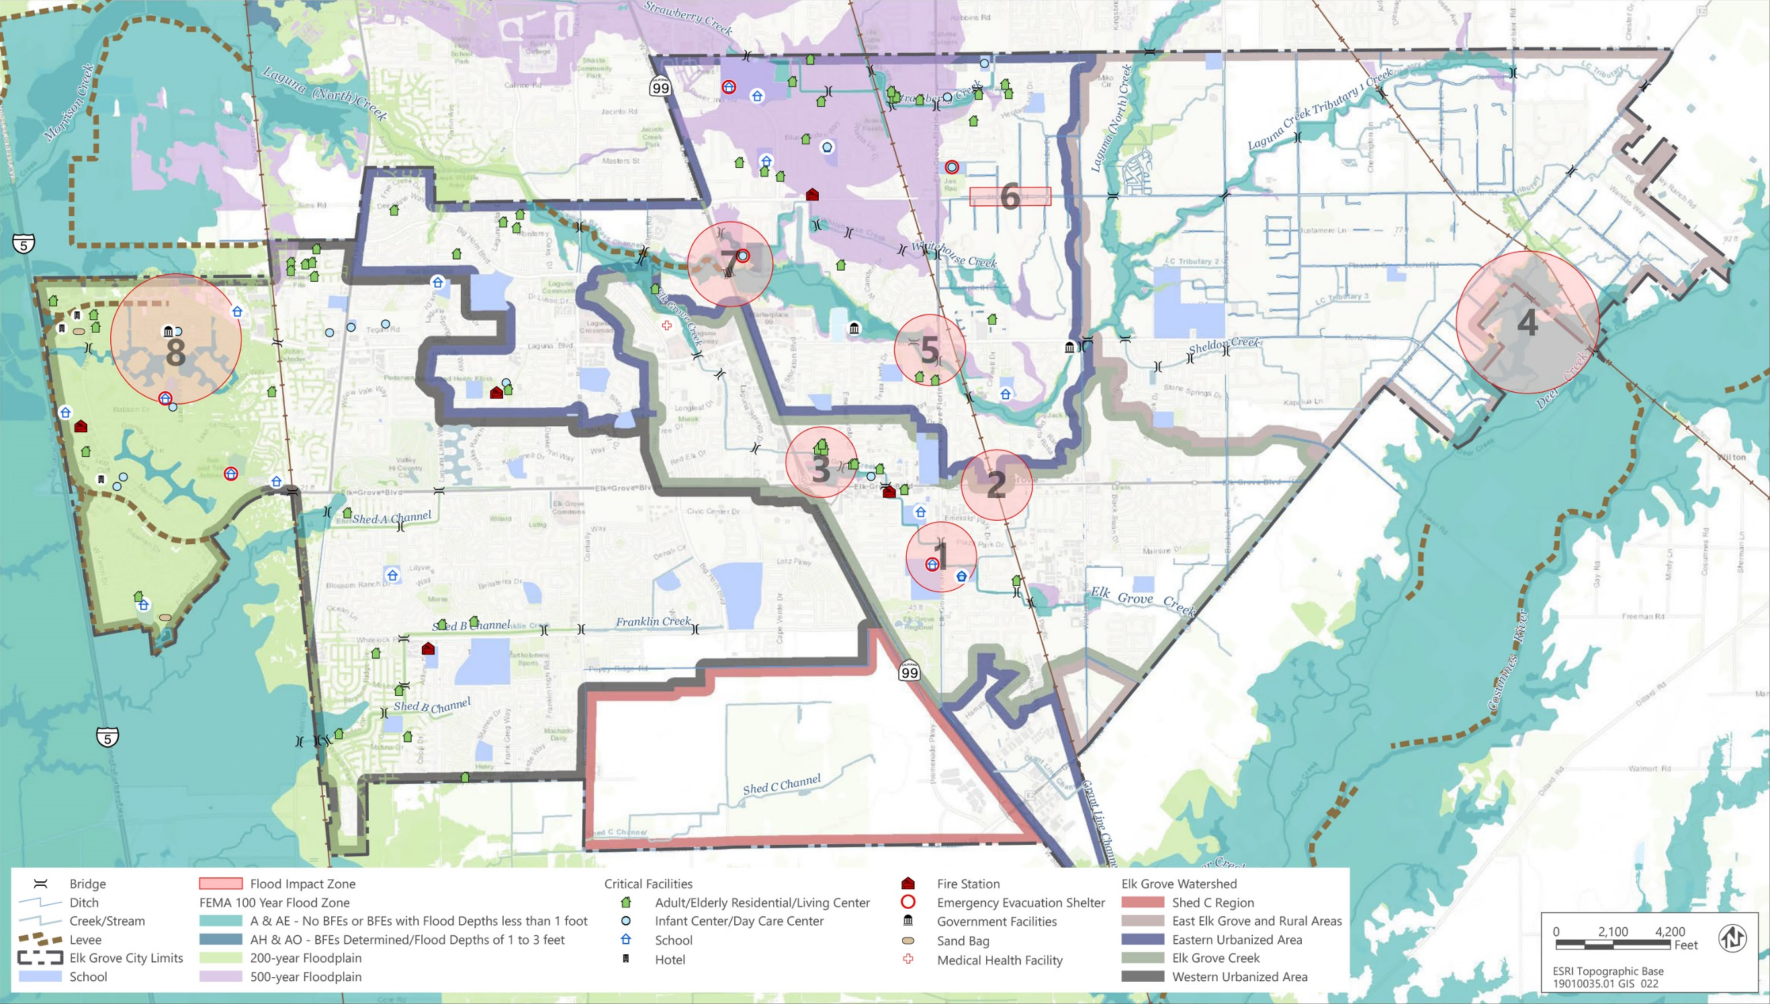

Slide 25

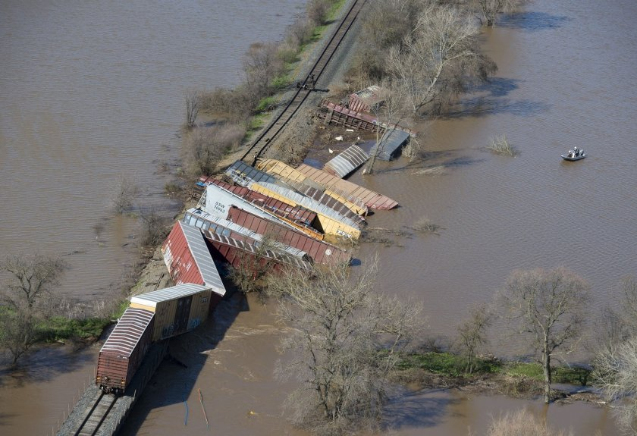
Flooding Impacts
Stormwater Drainage Impacts
  Drainage overflows
  Clogged drains with debris
Transportation Flooding Impacts
  Subbase erosion of roadways
  Concrete corrosion of roadways
  Route closures due to flooding
  Rail and railway roadbed damage
Notes:
Stormwater management systems are designed to manage runoff from storms of a certain size based on historic data
As these storms increase in intensity they will likely be impacts on the system and secondary impacts on the transportation system

Slide 26
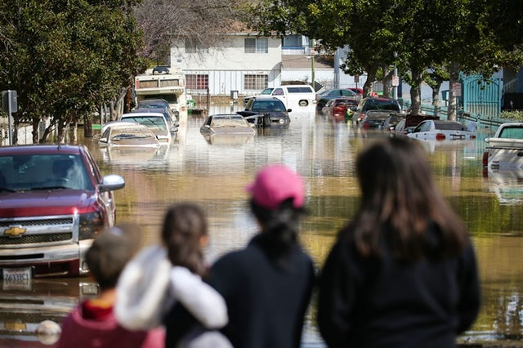
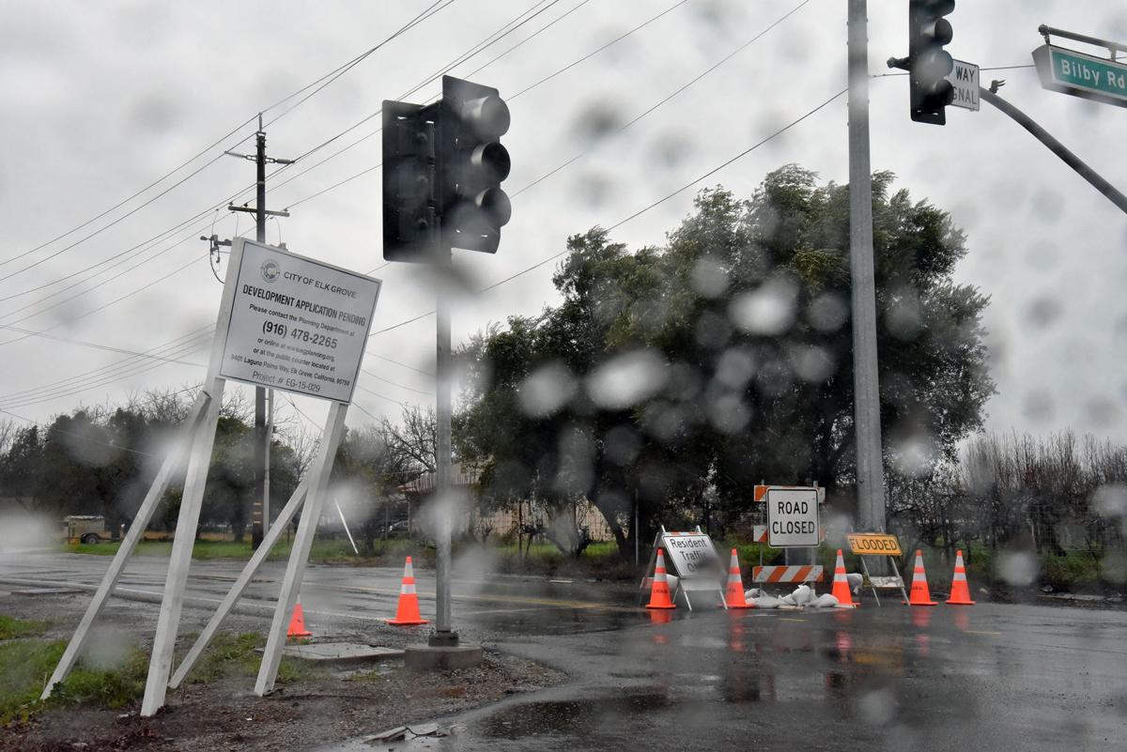
Flooding Impacts
Population Impacts
  Increased flooding risk for residents in and near flood zones
  Potential increases in property damage
Community Impacts
  Potential disruption of signal operations
  Travel delays due to flooding
  Increased need for emergency services

Slide 27
Climate Resilience Strategies:
Heat and Flooding

Slide 28
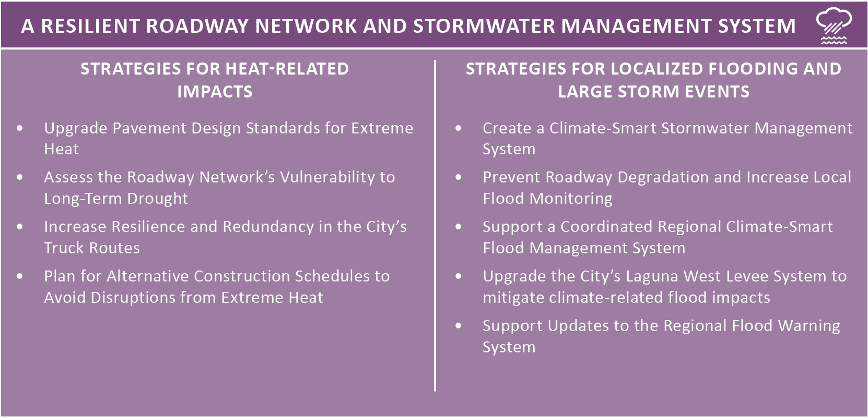
Climate Resilience Strategies
Notes:
RDT-1: Implement General Plan Chapter 5, “Economy and the Region
Implement “Economy and the Region,” of the City’s General Plan
Prioritize City expansion of the City’s broadband and fiberoptic cable network to attract new large employers.
Focus future planning decisions to attract remote workers from industries shifting to permanent work-from-home policies
RDT-2: Explore New Tax Offset Policy
Explore other forms of tax increases, outside of sales tax, to offset decreases in vehicle-related sales tax revenue in the future.
Explore the feasibility and likely acceptance of an increase in the City’s local sales tax as a tool to offset revenue lost
Explore options to develop a sales tax increase on e-commerce conducted in the City to capture revenue from business transactions that otherwise would be taxed from brick and mortar businesses.

Slide 29
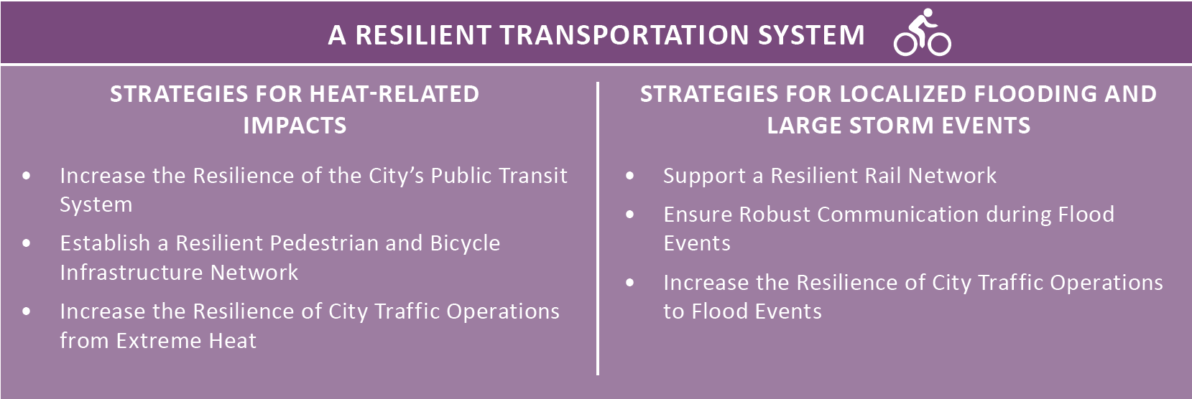
Climate Resilience Strategies
Notes:
RDT-1: Implement General Plan Chapter 5, “Economy and the Region
Implement “Economy and the Region,” of the City’s General Plan
Prioritize City expansion of the City’s broadband and fiberoptic cable network to attract new large employers.
Focus future planning decisions to attract remote workers from industries shifting to permanent work-from-home policies
RDT-2: Explore New Tax Offset Policy
Explore other forms of tax increases, outside of sales tax, to offset decreases in vehicle-related sales tax revenue in the future.
Explore the feasibility and likely acceptance of an increase in the City’s local sales tax as a tool to offset revenue lost
Explore options to develop a sales tax increase on e-commerce conducted in the City to capture revenue from business transactions that otherwise would be taxed from brick and mortar businesses.

Slide 30
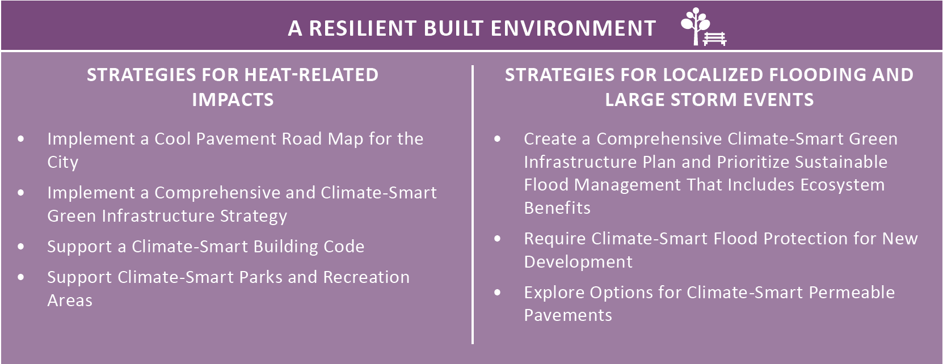
Climate Resilience Strategies
Notes:
RDT-1: Implement General Plan Chapter 5, “Economy and the Region
Implement “Economy and the Region,” of the City’s General Plan
Prioritize City expansion of the City’s broadband and fiberoptic cable network to attract new large employers.
Focus future planning decisions to attract remote workers from industries shifting to permanent work-from-home policies
RDT-2: Explore New Tax Offset Policy
Explore other forms of tax increases, outside of sales tax, to offset decreases in vehicle-related sales tax revenue in the future.
Explore the feasibility and likely acceptance of an increase in the City’s local sales tax as a tool to offset revenue lost
Explore options to develop a sales tax increase on e-commerce conducted in the City to capture revenue from business transactions that otherwise would be taxed from brick and mortar businesses.

Slide 31
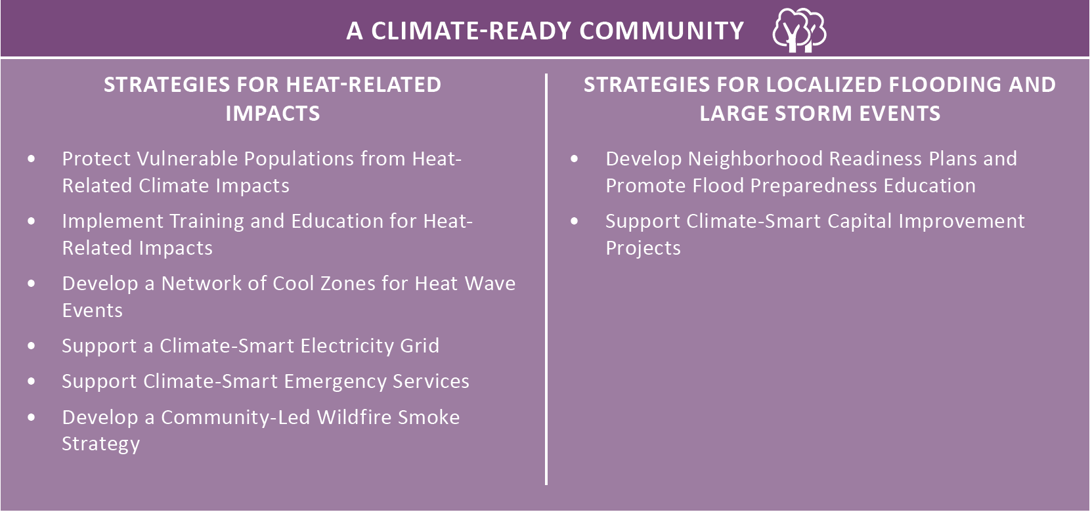
Climate Resilience Strategies
Notes:
RDT-1: Implement General Plan Chapter 5, “Economy and the Region
Implement “Economy and the Region,” of the City’s General Plan
Prioritize City expansion of the City’s broadband and fiberoptic cable network to attract new large employers.
Focus future planning decisions to attract remote workers from industries shifting to permanent work-from-home policies
RDT-2: Explore New Tax Offset Policy
Explore other forms of tax increases, outside of sales tax, to offset decreases in vehicle-related sales tax revenue in the future.
Explore the feasibility and likely acceptance of an increase in the City’s local sales tax as a tool to offset revenue lost
Explore options to develop a sales tax increase on e-commerce conducted in the City to capture revenue from business transactions that otherwise would be taxed from brick and mortar businesses.

Slide 32
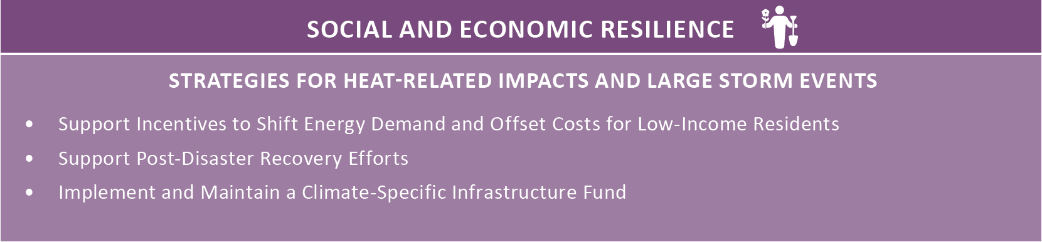
Climate Resilience Strategies
Notes:
RDT-1: Implement General Plan Chapter 5, “Economy and the Region
Implement “Economy and the Region,” of the City’s General Plan
Prioritize City expansion of the City’s broadband and fiberoptic cable network to attract new large employers.
Focus future planning decisions to attract remote workers from industries shifting to permanent work-from-home policies
RDT-2: Explore New Tax Offset Policy
Explore other forms of tax increases, outside of sales tax, to offset decreases in vehicle-related sales tax revenue in the future.
Explore the feasibility and likely acceptance of an increase in the City’s local sales tax as a tool to offset revenue lost
Explore options to develop a sales tax increase on e-commerce conducted in the City to capture revenue from business transactions that otherwise would be taxed from brick and mortar businesses.

Slide 33
Plan Implementation

Slide 34
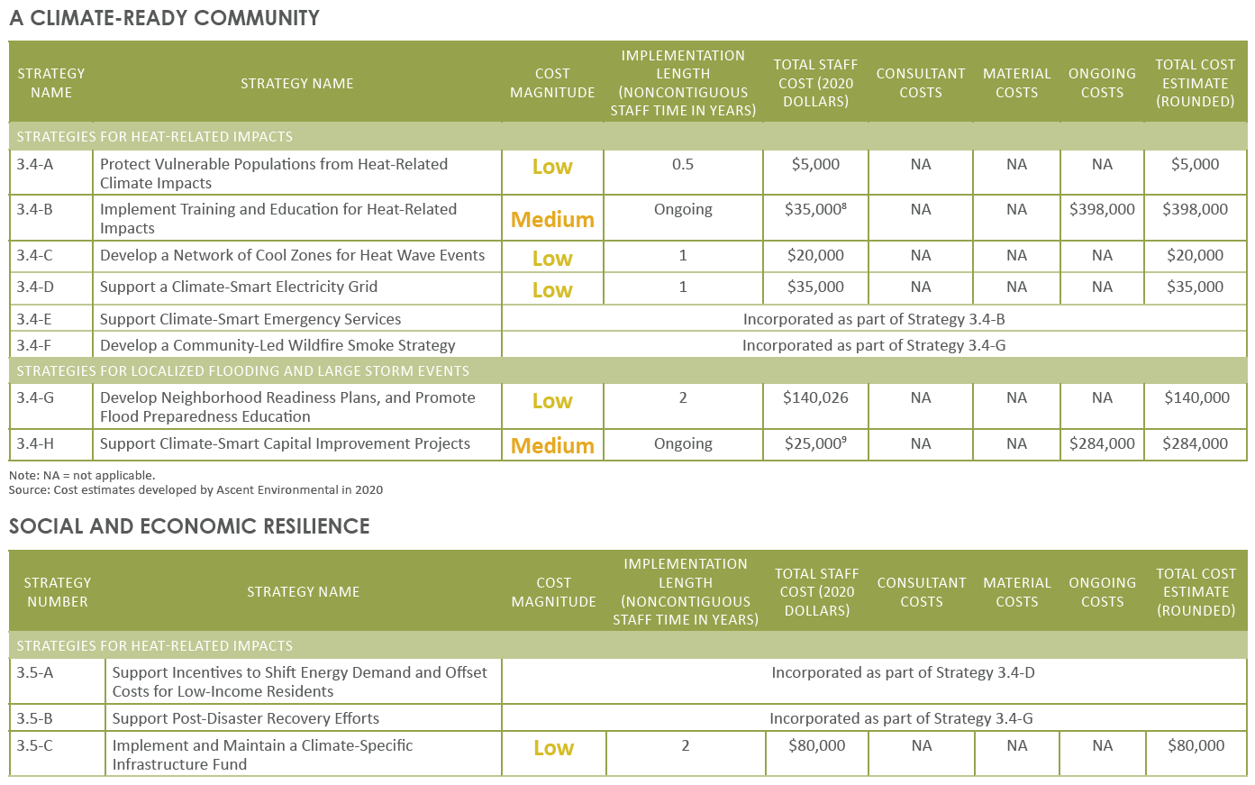
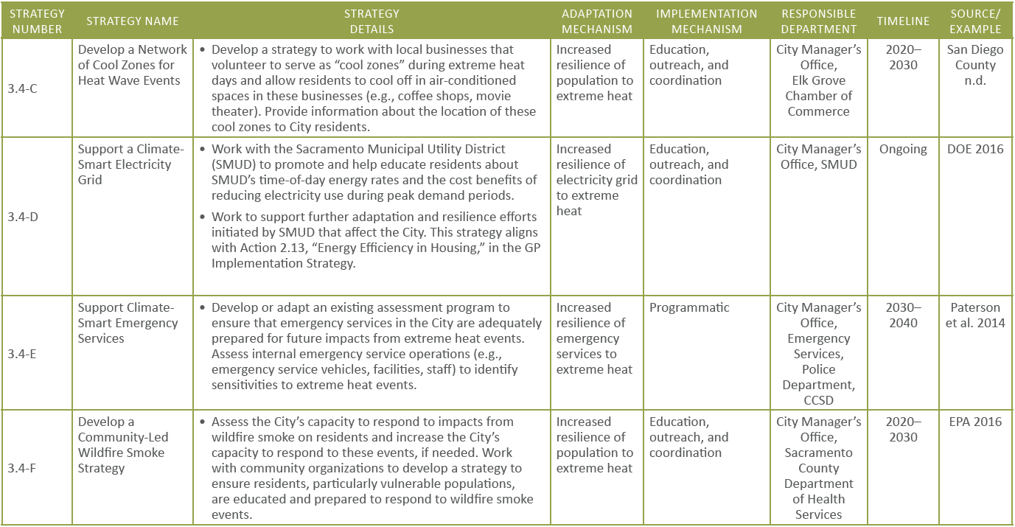
Strategy Implementation Details
Notes:
Stormwater management systems are designed to manage runoff from storms of a certain size based on historic data
As these storms increase in intensity they will likely be impacts on the system and secondary impacts on the transportation system

Slide 35
Strategy Cost Estimate
Notes:
Stormwater management systems are designed to manage runoff from storms of a certain size based on historic data
As these storms increase in intensity they will likely be impacts on the system and secondary impacts on the transportation system

Slide 36
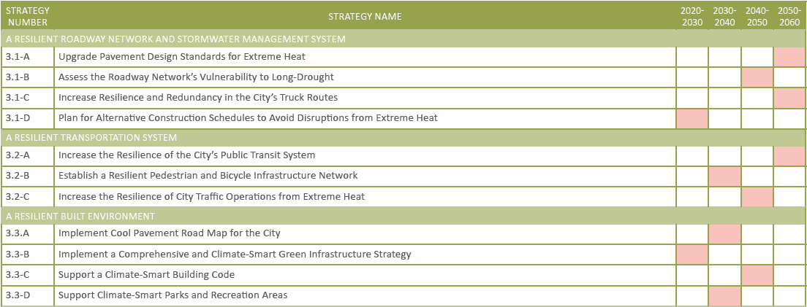
Strategy Implementation Timeline
Notes:
Stormwater management systems are designed to manage runoff from storms of a certain size based on historic data
As these storms increase in intensity they will likely be impacts on the system and secondary impacts on the transportation system

Slide 37
Community Outreach for Implementation
City establishing Community Resilience Task Force
Researching and pursuing grants and funding opportunities to implement strategies
Community Mobility Resilience Plan StoryMap
Notes:
Carrie and Matt

Slide 38
Questions and Answers

Slide 39
Questions and Answers
What additional information would be helpful for residents to prepare for the impacts of climate change?
Notes:
Carrie and Matt

Slide 40
Questions and Answers
How can the City best help residents prepare for climate impacts (e.g., education, training, resources)?
Notes:
Carrie and Matt

Slide 41
Questions and Answers
What are the biggest barriers you see for households to prepare for climate impacts?
Notes:
Carrie and Matt

Slide 42
Next Steps

Slide 43
Next Steps
Review plan and provide comments to Carrie Whitlock at cwhitlock@elkgrovecity.org by January 25
Planning Commission on February 18
City Council on March 10
Lookout for opportunties to participate in plan implementation
Tell your community about the Plan and StoryMap website
Notes:
Carrie and Matt

Slide 44
Thank You!
Notes:
Carrie

